Slide 1
FOOD RECIEPE BLOG APPLICATION
Presented By: Spurthi Shetty, Pooja Pingle, Yash Khopkar, Ruta Lad, Rajashree Naik

Slide 2
EXISTING SYSTEM
Only the bloggers will be able to sign-up and login and will be able to change and delete recipes from their wall
The Website includes different categories of Recipes which are displayed accordingly
There was no social media link for the recipes
There is no chat box present in the existing system.
User cannot edit/delete any food blog once posted.
User cannot share any blog on social media or any other platform.

Slide 3
IMPROVEMENTS
Chat bot
Video tutorial for all levels
Explore by ingredient, dish type, method, cuisine
Popular section
Equipment used for cooking review section
Notification messages about new recipes
Comments and remarks
Sharing options on social media

Slide 4
FLAWS
The recipe should be written like a professional to attract the users. It should have two main parts – ‘The Ingredient List’ and ‘The Preparation Method’
List all ingredients in order of use, as described in step-by-step instructions. List the most important ingredients first, if it can be consistent with order of use. Spell out everything: tablespoons, ounces, etc. The Preparation Method do not have to write complete sentences. Be as short and concise as possible. State exact or approximate cooking times, with descriptive hints for doneness
User cannot bookmark the recipe or the blog.

Slide 5
The site has no sections of featured, popular and latest food blogs.
The site has no filter options for the users to search for particular kind of recipes.(Eg. Indian, chicken recipes)
Every recipe has no comment section as well.
The blogger has no about me section on the site for the users to know about the blogger more.

Slide 6
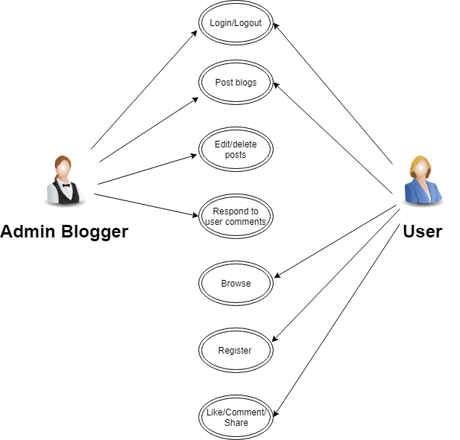
USE CASES

Slide 7
MOONSHOTS
Calorie Count and Benefits
Applying artificial intelligence and behavioral science and nutrition-focused concepts with cutting-edge techniques.
Live video streaming with the food blogger

Slide 8
STRATEGY PLANE(User Needs)
As a User following things will be expected:
If user is getting all the recipes of all categories from the sites
Save time and energy by creating content that specifically meets users needs.
Education - Take the education component to a new level and into a blog post.
This can be an excellent way to provide education that may otherwise be lost when
weight loss and diet take precedence.
Recipe Roundups - Providing multiple recipes on specific types of food can help your
user and other readers who wish for the same types of recipes
Recipe Development - If a dietitian maintains a food blog, finding the time to perfect recipe development skills is essential
Fitness - blog that provides educational content and recipes often based on current events and food trends.

Slide 9
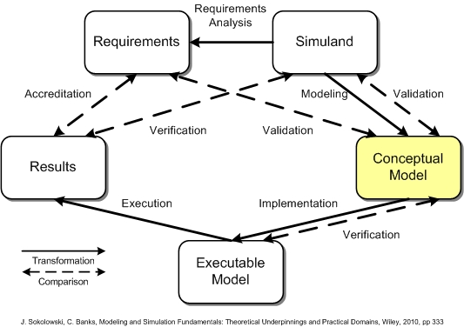
STRUCTURAL PLANE(Conceptual Model)

Slide 10
STRUCTURAL PLANE(ERROR HANDLING)
Error handling refers to the anticipation, detection, and resolution of programming, application, and communications errors.
We have implemented:
Password and email validation to ensure only valid users are allowed to access the blog.
A minimum 8 characters password contains a combination of uppercase and lowercase letter and number are required.
These are error messages that adapt based on what invoked the validation error and use this to provide the user with helpful instructions on how they can correct their input.

Slide 11
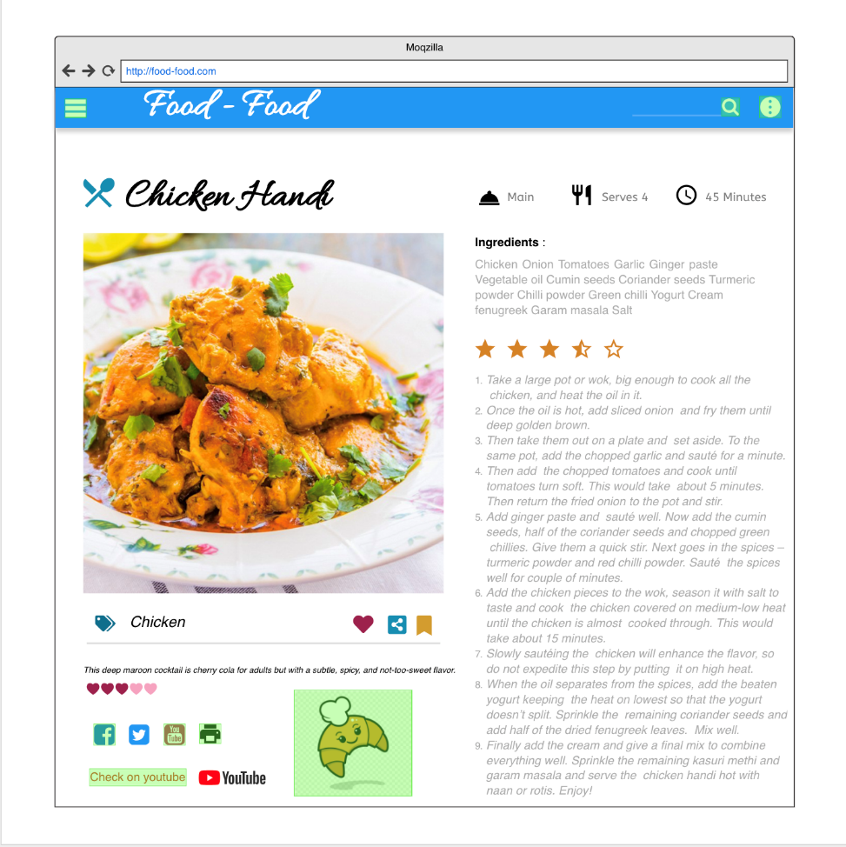
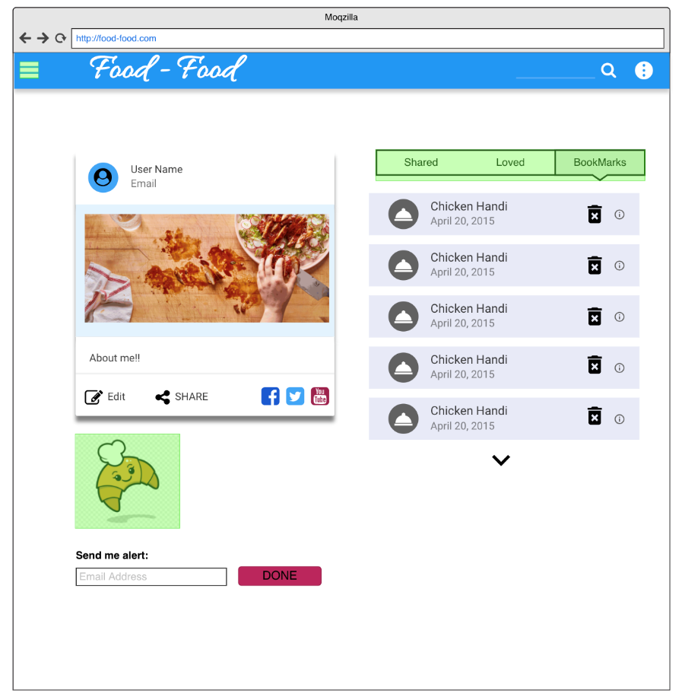
WIREFRAME MODEL

Slide 12
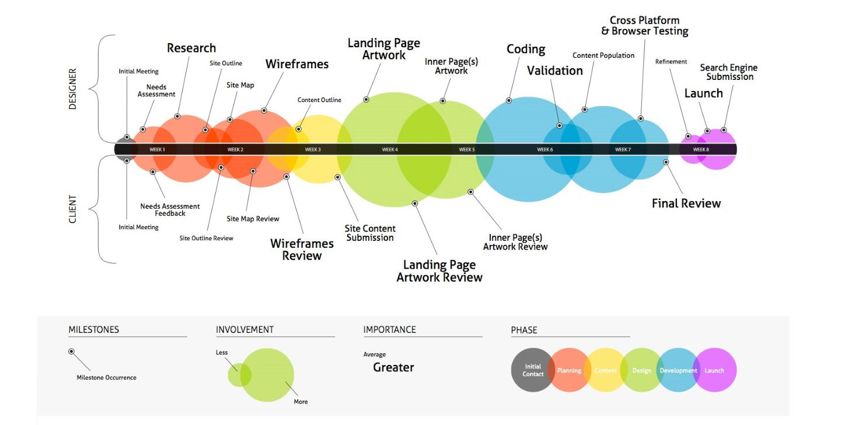
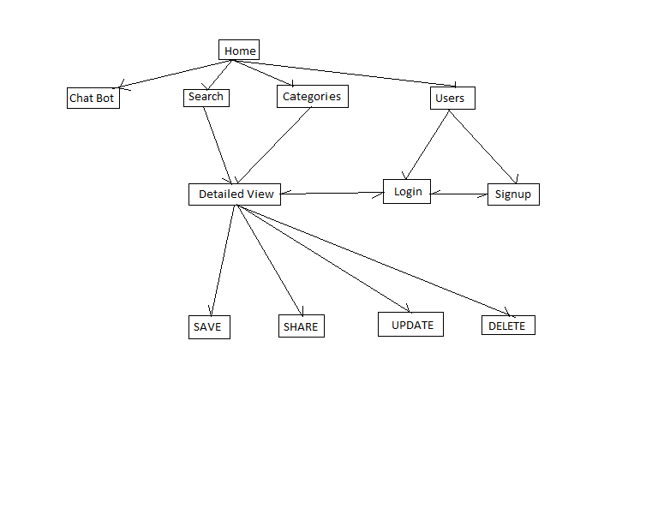
INFORMATION ARCHITECTURE

Slide 13
INFORMATION ARCHITECTURE
There are various phases in information architecture
Initial Contact, Planning, Comments, Design, Development, Launch.
There are two roles in Information Architecture
Designer and Client
Some of the tasks the designer will accomplish are:
Research, Create Wireframes, Pages, Coding, Validation and Testing
Client will provide various reviews depending on the work done by the designer and approve his work:
Some important reviews are:
Wireframe Reviews, Pages Reviews and Final Review

Slide 14
DESIRABILITY STUDIES
Participants are offered different visual-design alternatives and are expected to associate each alternative with a set of attributes selected from a closed list; these studies can be both qualitative and quantitative.
User experience is all about catering the design of a product or service to fit the needs of users. UX research plays an important part in this, helping your thoroughly understand those users, assess how well you’re serving their needs, and uncover opportunities to create something even better.
Desirability studies actually do more than just measure, as they can also be used to inform and even inspire different visual design directions you may be considering.
Desirability studies are far less well known, despite how important visual design is to user interfaces.

Slide 15
USABILITY STUDIES
Participants are brought into a lab, one-on-one with a researcher, and given a set of scenarios that lead to tasks and usage of specific interest within a product or service.
A usability lab is a place where usability testing is done. It is an environment where users are studied interacting with a system for the sake of evaluating the system's usability.
The purpose of the practice is to discover any missed requirements or any kind of development that was seen to be intuitive but ended up confusing new users. By testing user needs and how they interact with the product, designers are able to assess on the product's capacity to meet its intended purpose.

Slide 16
PERSONAS
Chef: Chef’ s will be able to see various recipes and decide accordingly. They would also be able to view calorie counts of various recopies and decide accordingly.
Dietician: Dietician could effectively view recipes calorie counts and accordingly suggest recipes to their patients and clients

Slide 17
PERSONAS
Blogger: Bloggers can view various recipes and look at the ingredients, methods to cook. They can even provide feedback/ improvements which they feel can make the re recipes better.
Normal user: Users Bloggers can view various recipes and look at the ingredients, methods to cook, interact with other users and view preparation videos.

Slide 18
THANK YOU!

